Slide 1

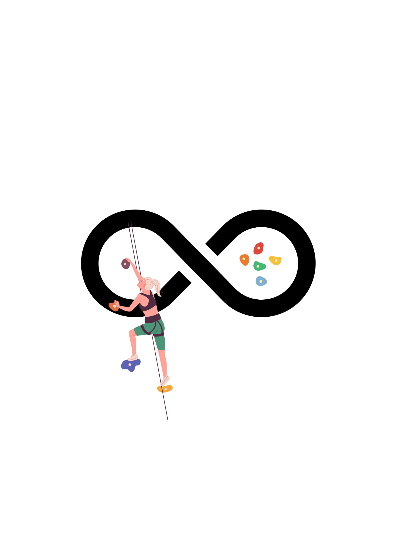
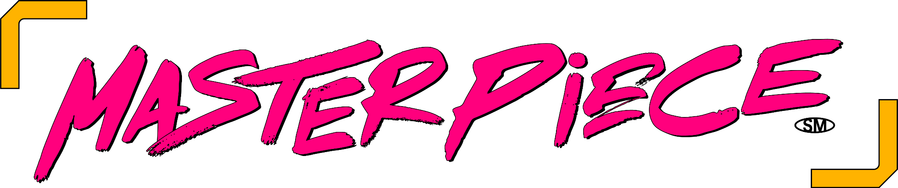
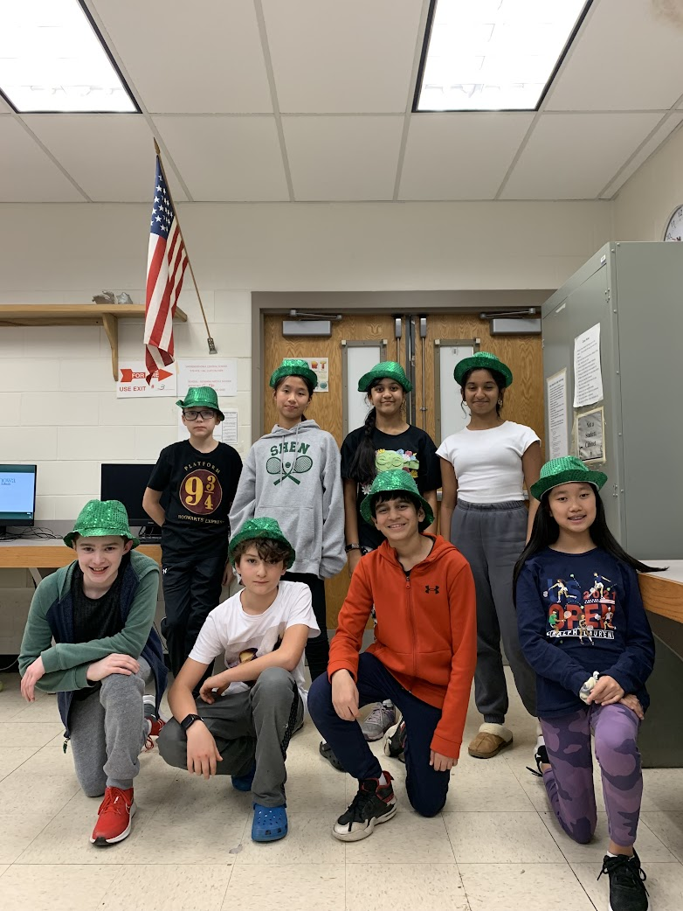
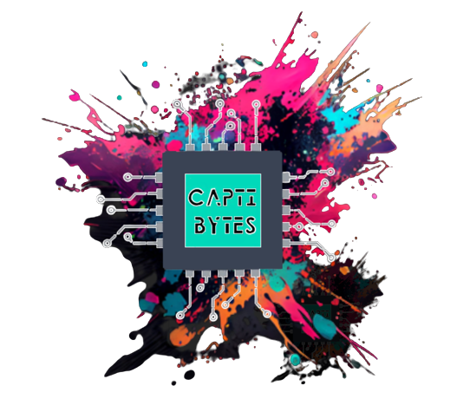
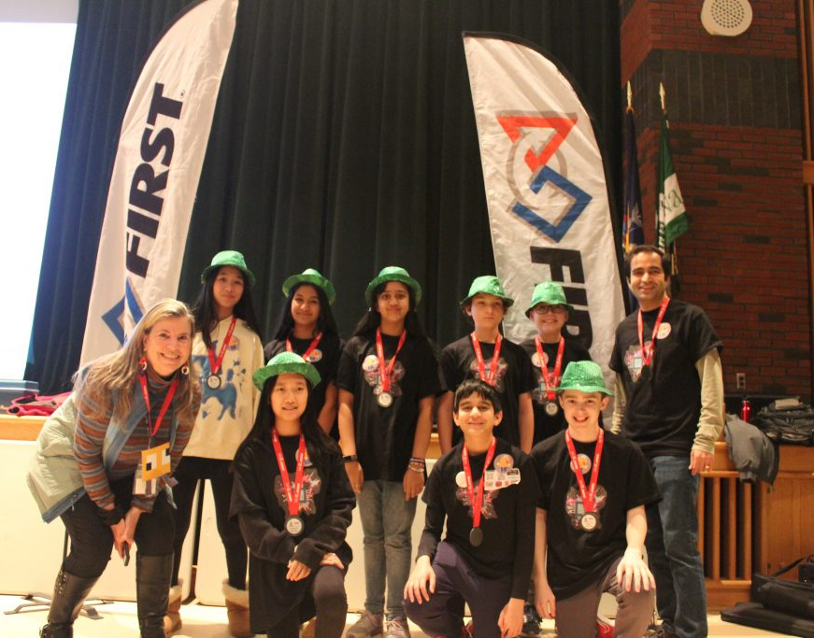
CAPTIBYTES
#3249

Slide 2
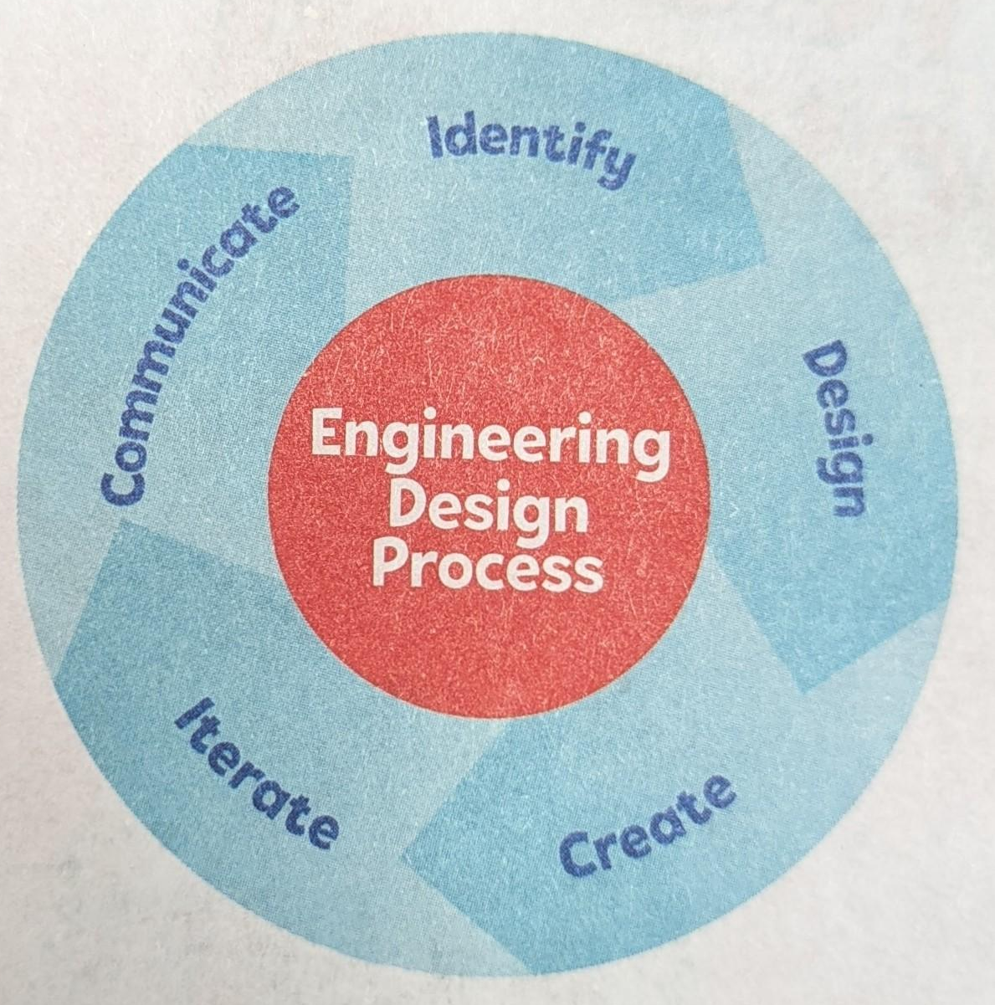
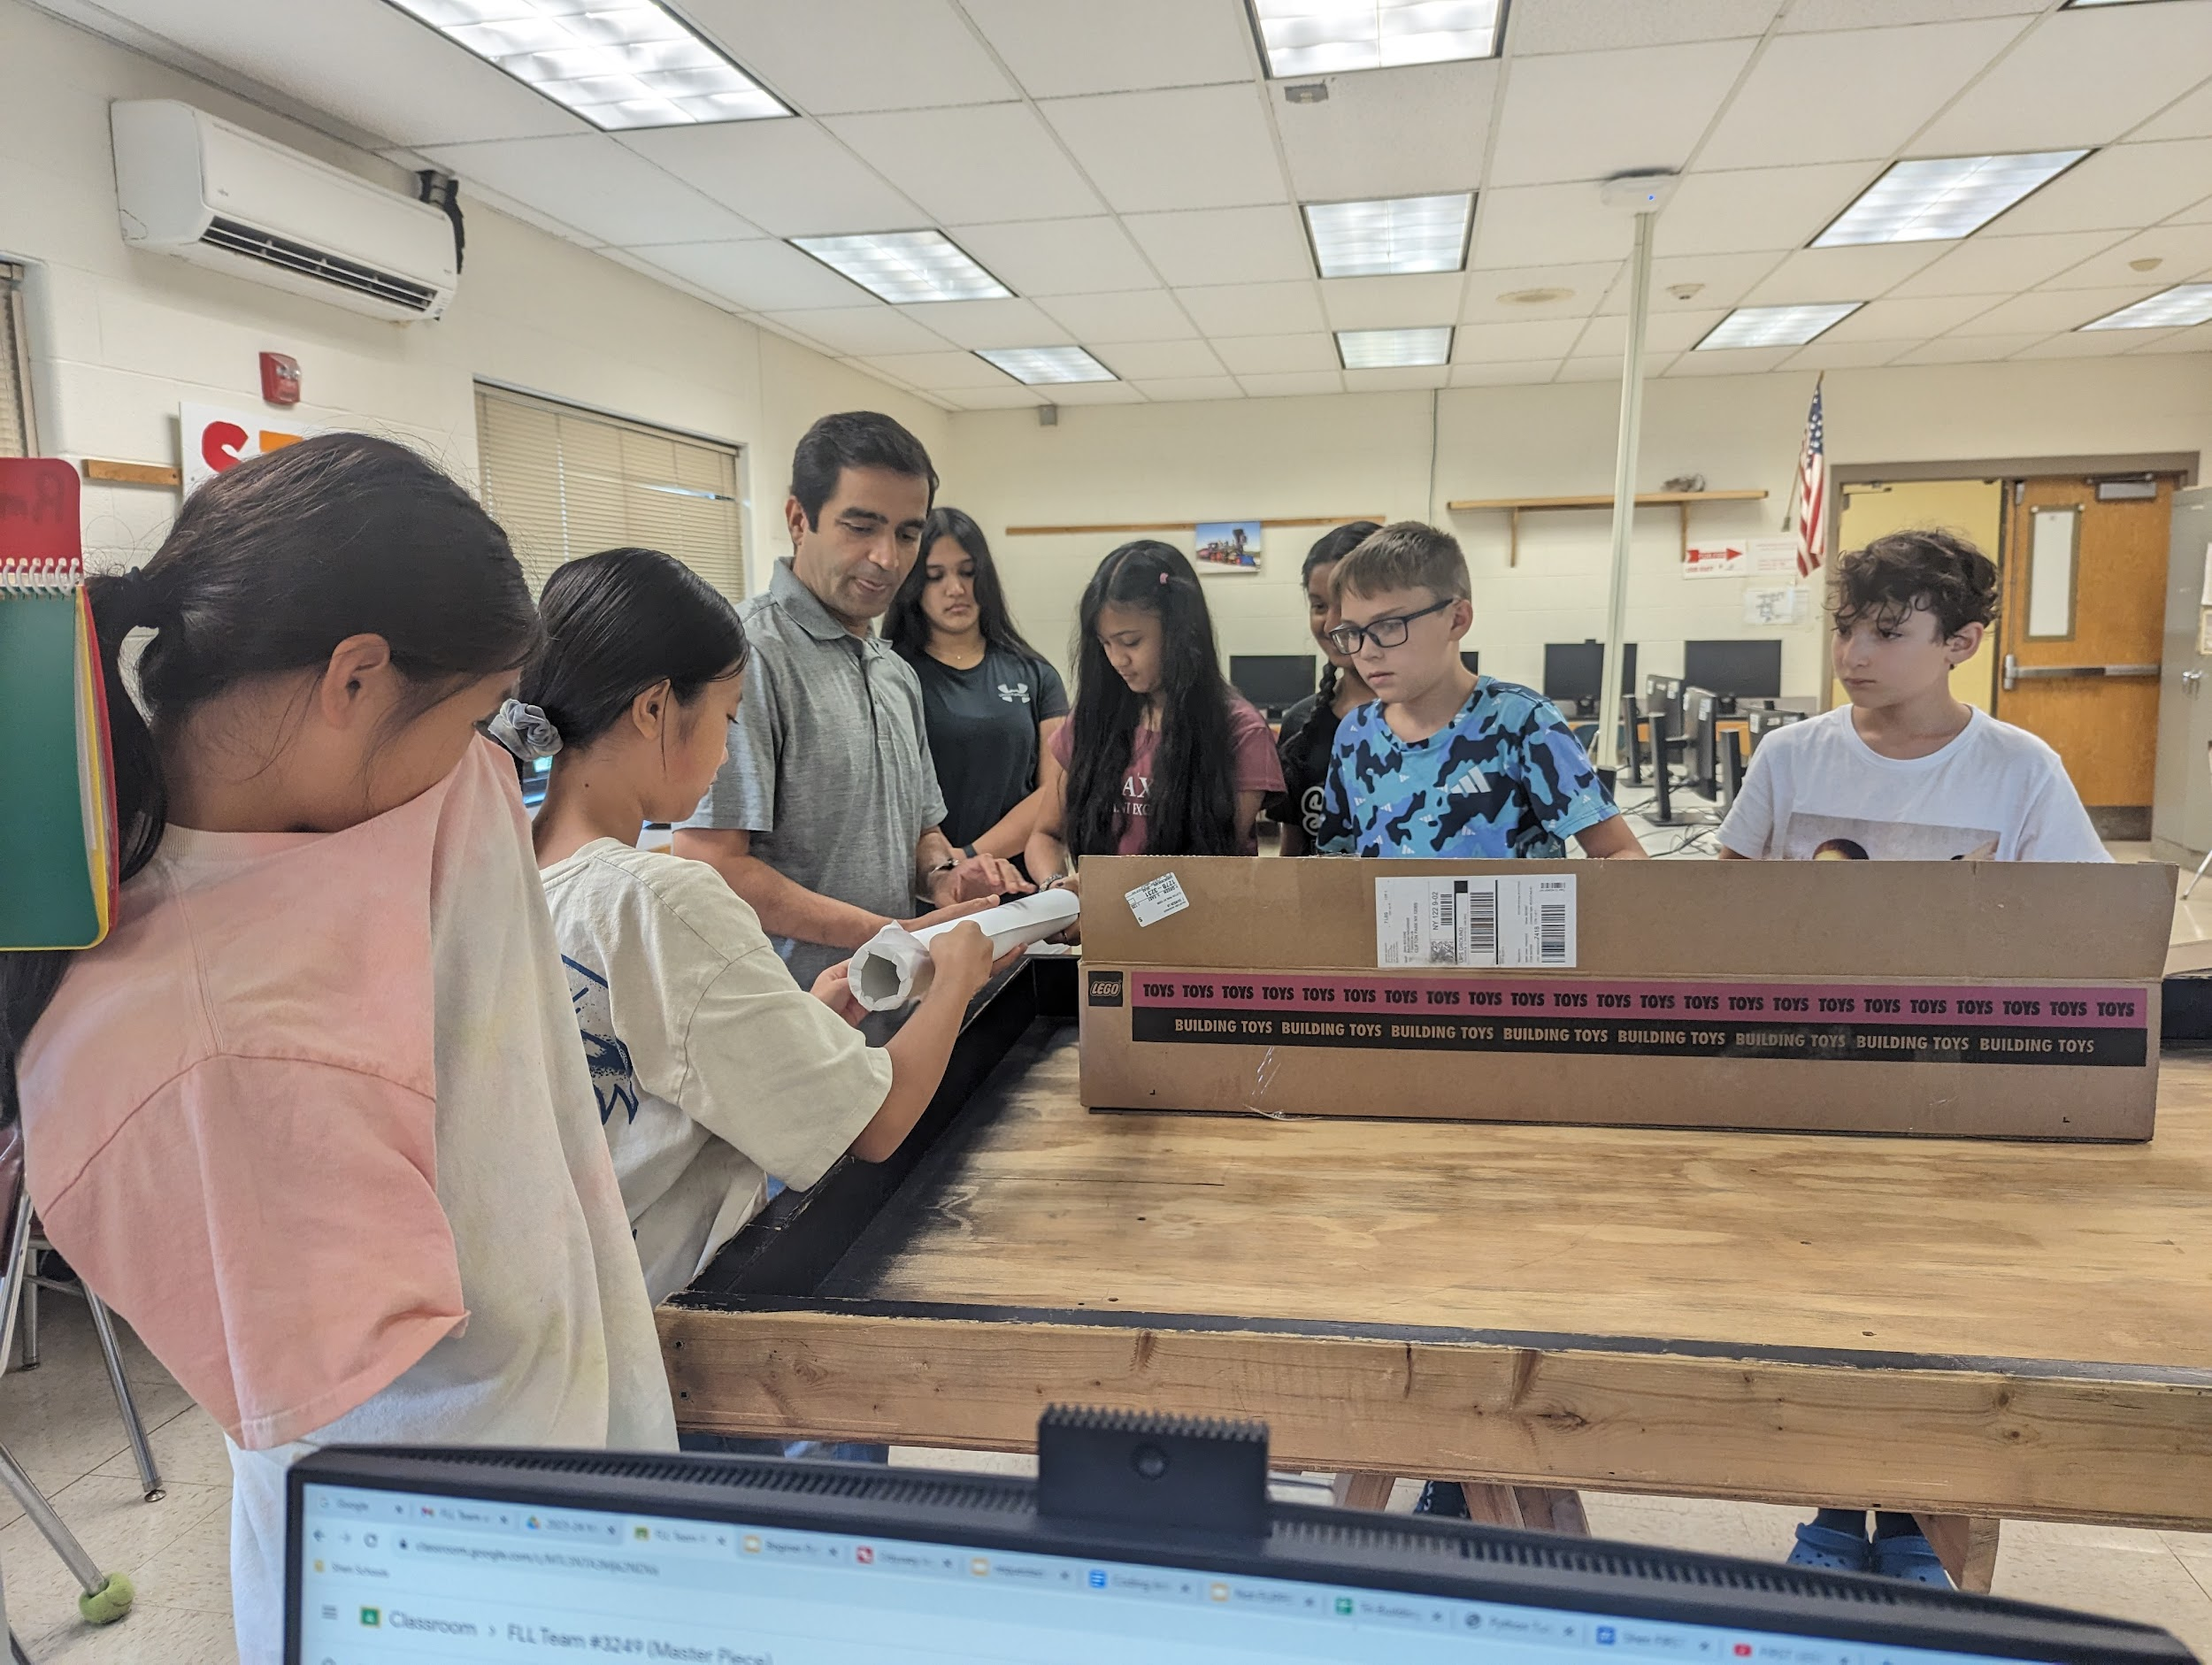
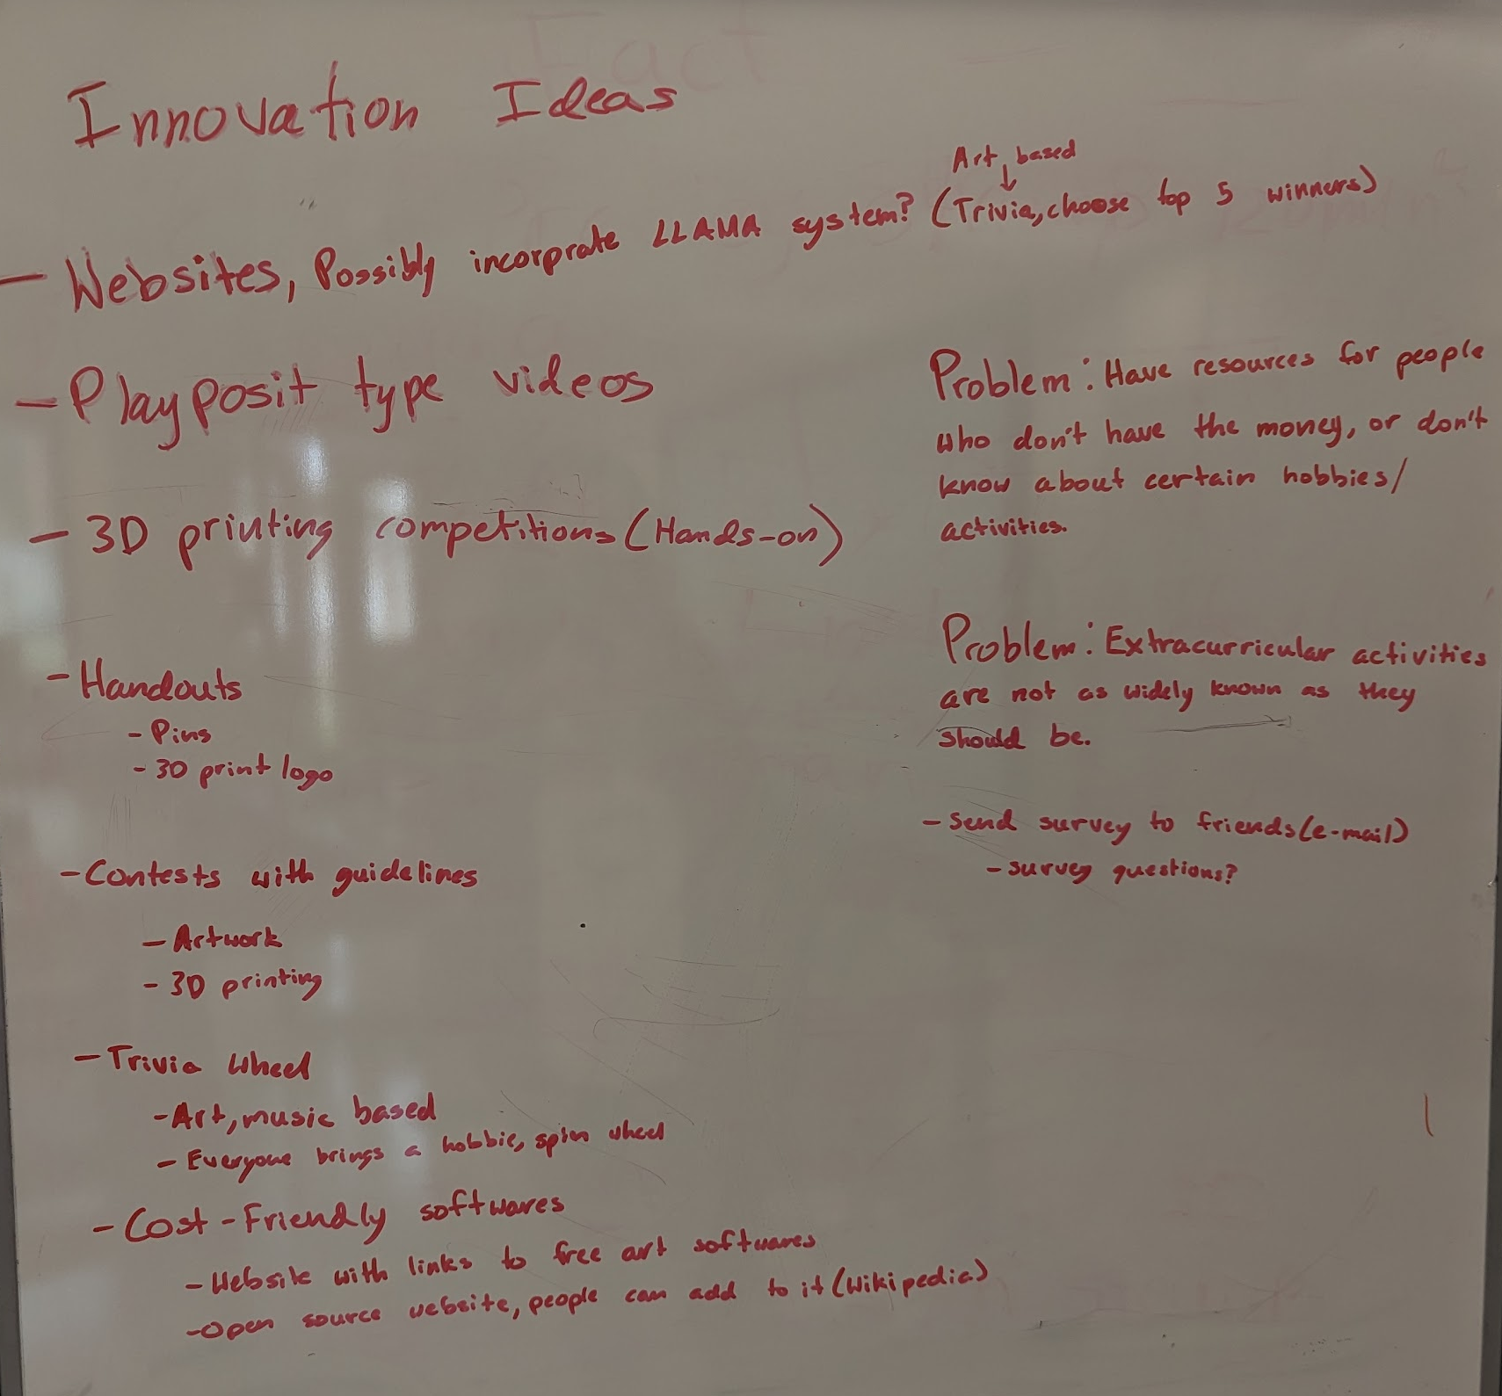
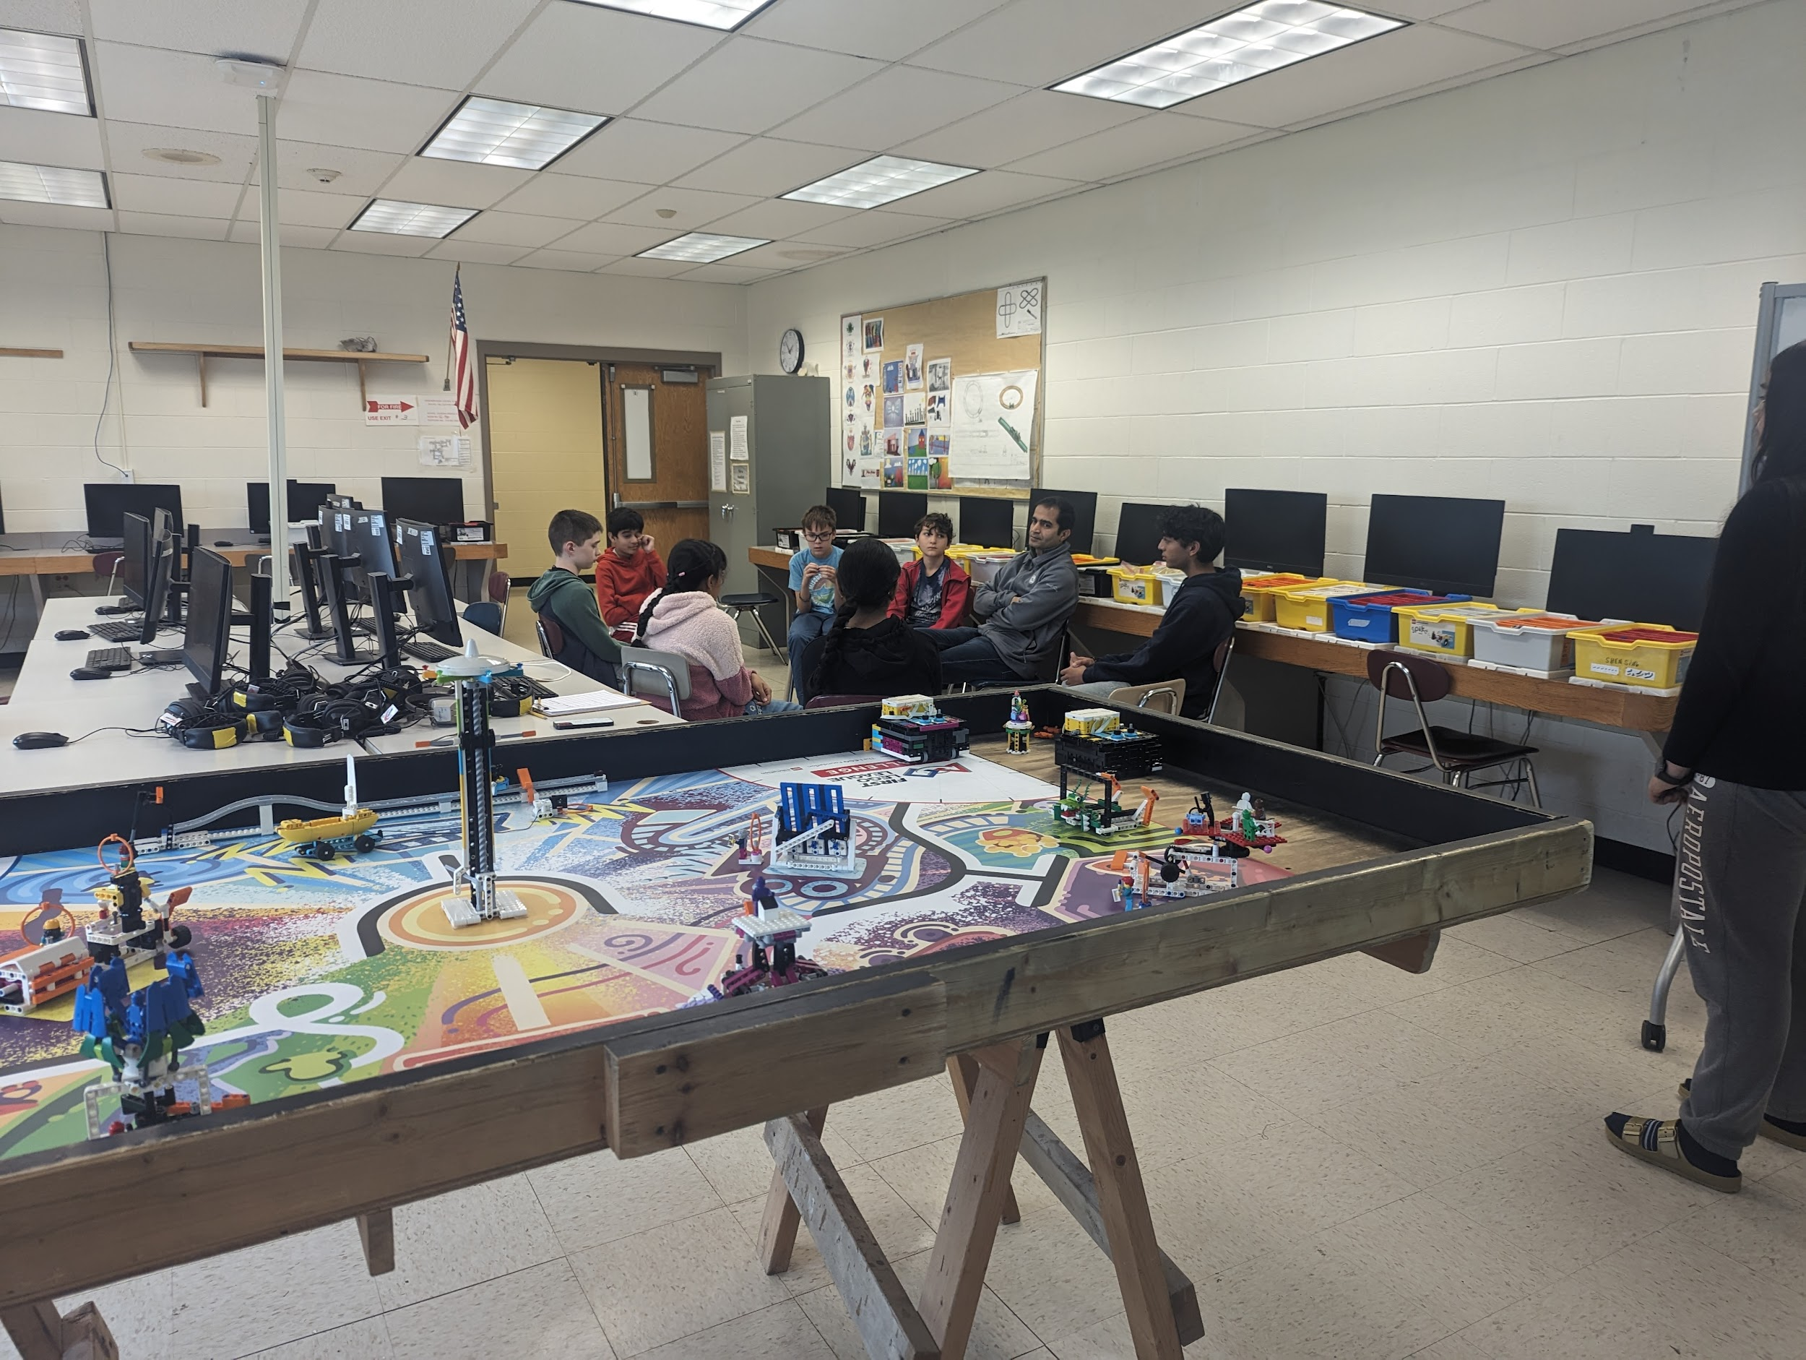
Season Timeline - Innovation
Early Oct 2023
Mid Oct 2023
Early Nov 2023
Sept 2023
- Kickoff meeting!
- Meet the team
- Researched/ brainstormed innovation problems
- Narrowed down/focused on one problem
- Found a creative solution
- Albany Public Library science/engineering event
- Sent out tri-building survey
- Compared solution with others
- Started making trivia skit

Slide 3


Late Nov 2023
Early Dec 2023
December 9th 2023
- Modified solution
- Created concept for advanced prototype
- Started building our prototype on Jotform.
- Jotted ideas for innovation skit
- Google Meet with Mr. Nardelli
- Finished our prototype
- Iterated prototype using feedback from counselors
- Finished & practiced innovation skit
FLL qualifier @ Shenendehowa HS East
We advanced to champs!

Slide 4
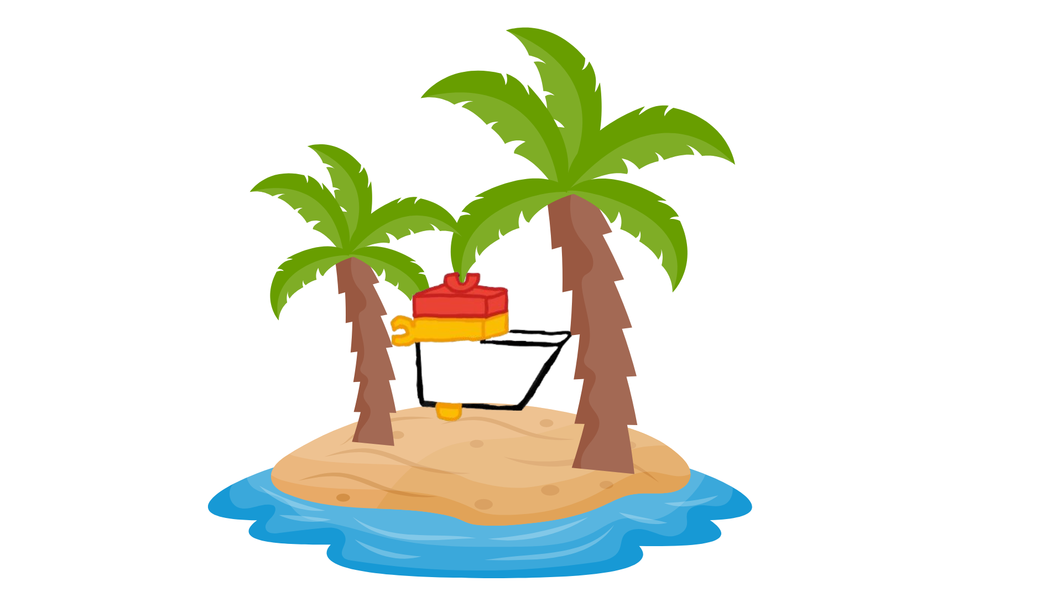
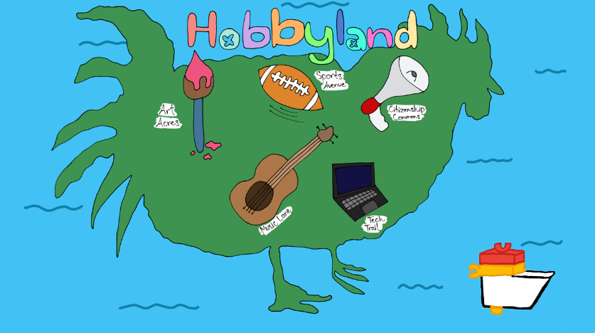
Late Dec 2023
Early Jan 2024
Late Jan 2024
Early Feb
2024
- Went over the innovation project meaning (challenge)
- Went over rubrics
- Decided to make a different innovation solution, Hobbyland
- Decided to still focus on various sports
- Started building Hobbyland
- Making changes to poster board
- Finished up Hobbyland
- Changed skit
- Made Hobbyland logo
- Finished skit
- Met with counselors
- Mr. McCreary
- Showed solution to friends and students
- Finished poster

Slide 5
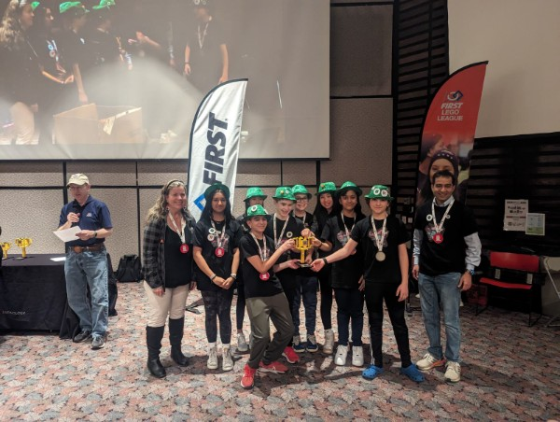
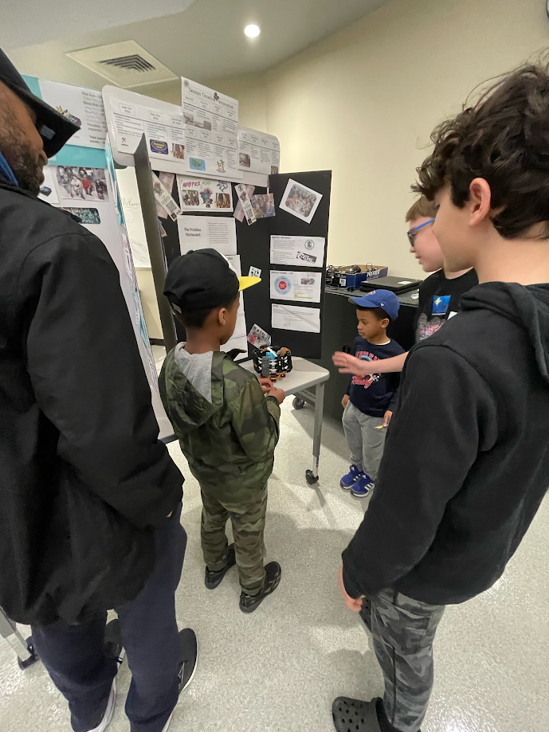
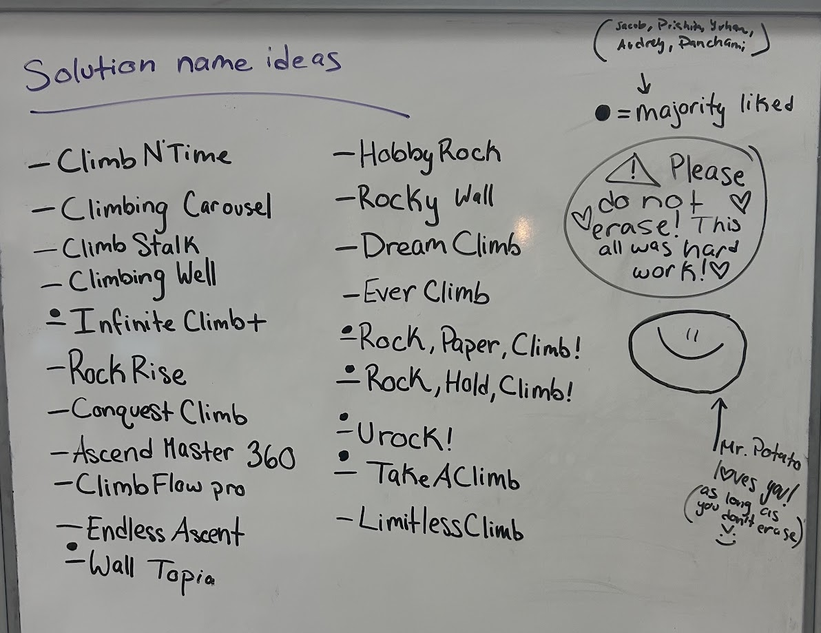
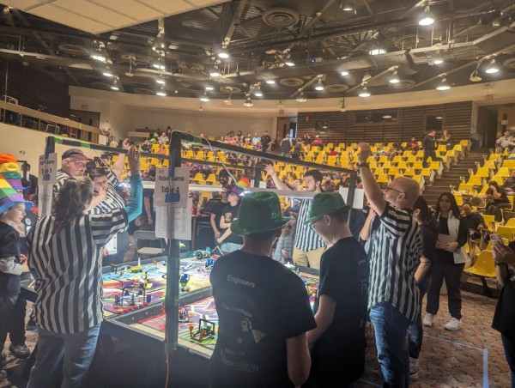
Feb 9th
2024
Early March
2024
Late March
2024
Early April
2024
- FLL championship @ RPI University
- We advanced to Nationals
- Decided to not continue with Hobbyland
- Went over the rubrics
- Brainstormed possible hobbies we liked and problems surrounding them
- Decided on rock climbing with a vote of 8 out of 8 people
- Visited The Edge for everyone to try rock climbing and make sure we wanted rock climbing.
- Talked with expert, Adam Catalano (manager of The Edge)
Decided on Shark Tank as skit theme
Finished the Shark Tank skit
Science Health & Discovery Night (outreach)

Slide 6
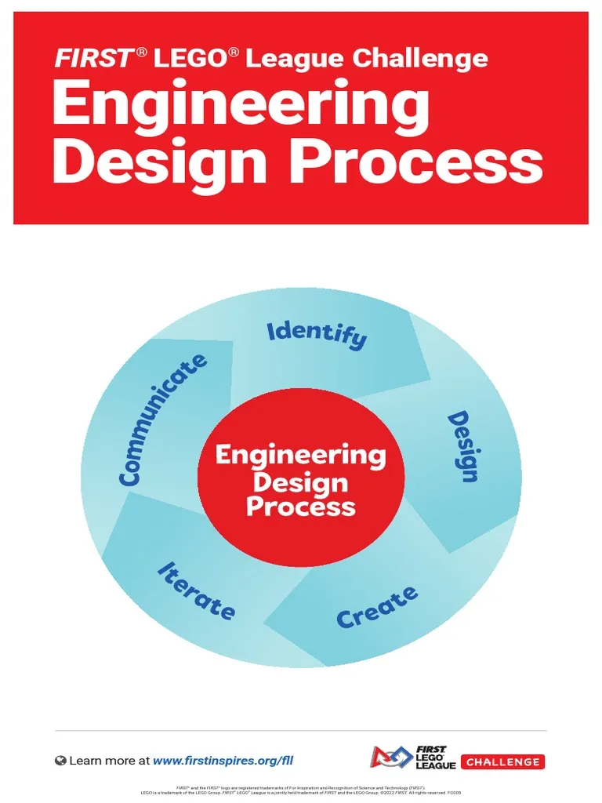
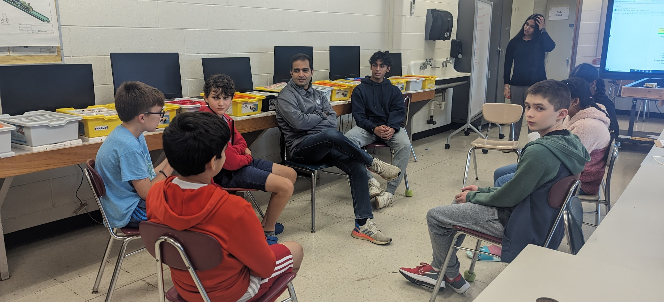
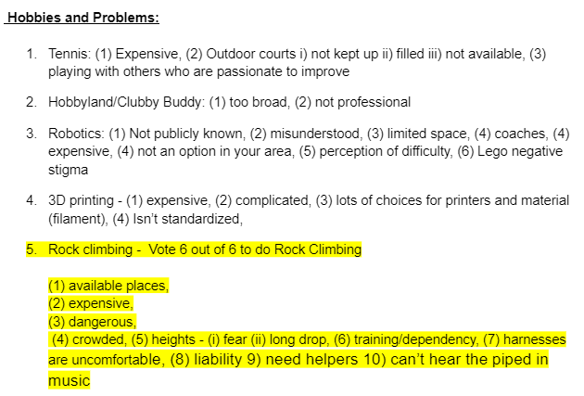
Our Decision Making Process:
Brainstorm ideas first
Narrow to a few ideas
Vote
Research Process - EDP

Slide 7
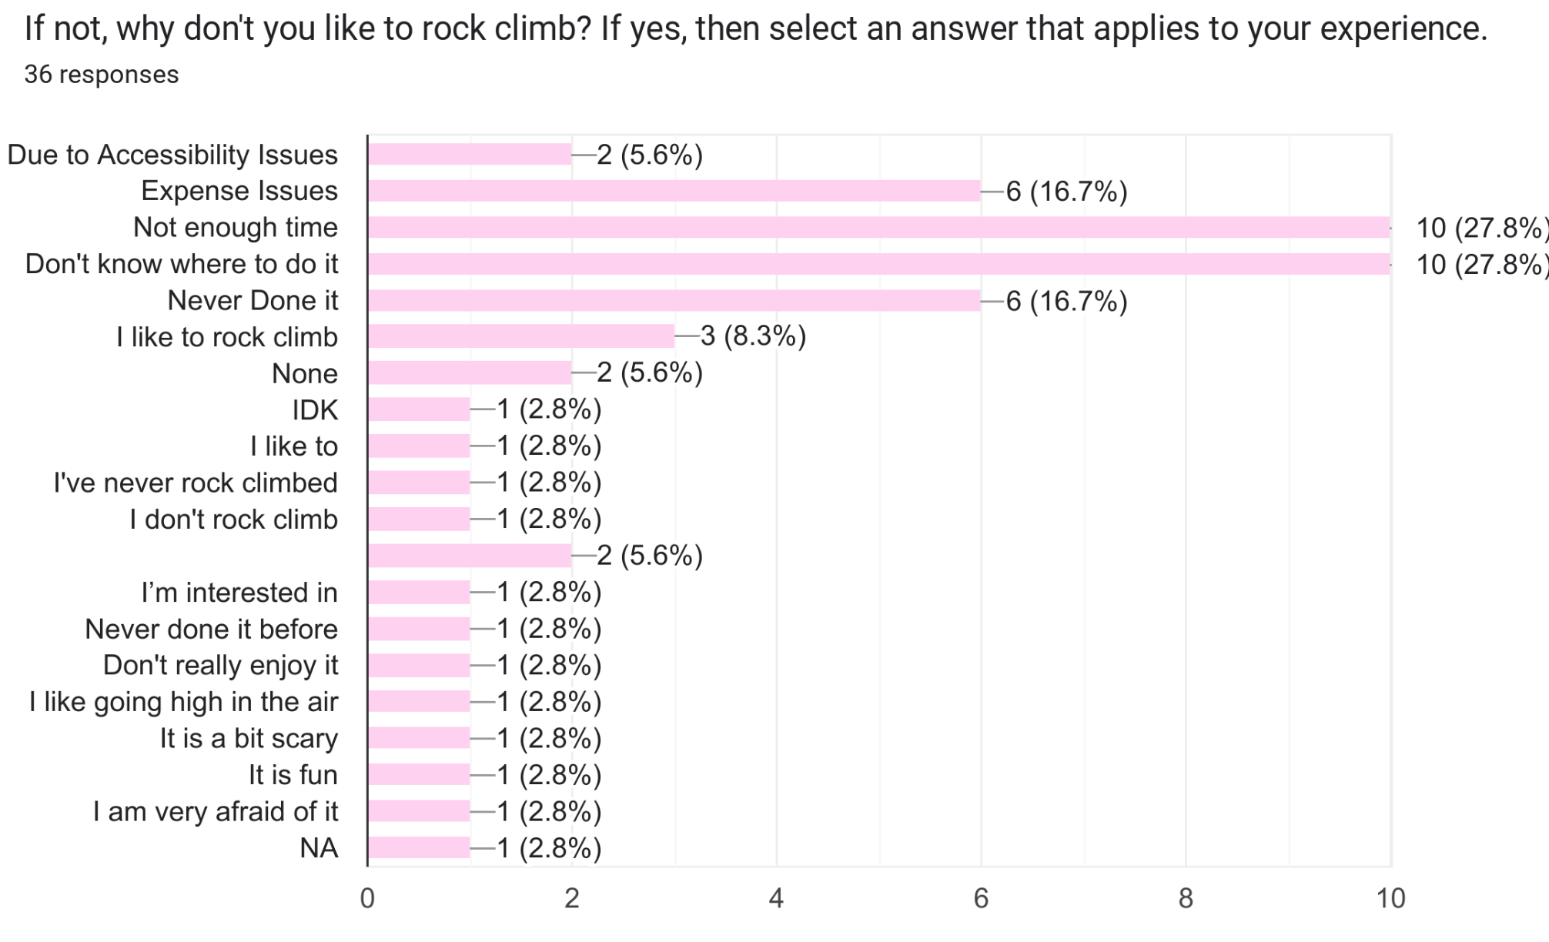

Survey/Potential End Users
We sent a google form survey to gain feedback on our solution for possible end users. We sent it out throughout the three middle schools; Acadia, Koda, & Gowana through the announcements. We also shared it with those at the FRC tournament at the MVP Arena, and climbers at The Edge. What we learned….. most said that the reasons they don’t climb is that they aren’t sure of where to go and don’t have enough time.

Slide 8
Brainstormed other problems:
Problem: | Description: | Pros: | Cons:
Learn to play Tennis | Expensive - Lessons & equipment & court rental Condition of Outdoor Courts; cracked, always filled up, weed, always have to play with other players Many people think its too easy without trying it | It is a big problem we face, even in our school and local community It would greatly help the tennis teams | Not all team members like tennis. Another FLL team is already working on a Tennis relating problem and solution.
Students unaware of Extracurricular activities (hobbies) | Students and people often don’t know about available activities in school or the community There might be cut-off deadlines, prerequisites, or resources that people were unaware of - this can block them from joining | A lot of students in Shenendehowa and other school districts face this problem Many possible solutions | Hard to create a unique solution It doesn’t relate to this year’s Innovation Theme Too broad, doesn’t focus on one hobby
FLL/Robotics | Not publicly known Misunderstood Limited Space Not an option in your area | All of us are interested in robotics and are part of a team | It’s too basic, not a lot of us are interested in these problems.

Slide 9
Brainstorming to Identify Solutions: ROCK CLIMBING
Solution: | Description: | Pros: | Cons:
Vertical Treadmill | Vertical treadmill, allowing infinite climbing area, has holds. | Simple, easy design that can be created easily | Doesn’t allow jumps or as much of a challenge for advanced climbers
Two Way Treadmill | Allows climbing both vertically, horizontally and sideways. (has holds) | Allows more of a challenge for advanced climbers allows far jumps in all directions | Is too hard to create as supports can’t be created and holds would get stuck
Vertical Treadmills in A Pentagonal Formation | 6-8 Vertical Treadmills with holds placed in a pentagonal formation | Allows big jumps and climbing horizontally and even more variation in climbing, pretty simple | It would be really expensive with many treadmills and would be pretty big
Note: all of these solution ideas include safety features and immersive features

Slide 10
Similar Solutions:
Solution: | Pros: | Cons: | How Our Solution Is Different:
Treadwall | Don’t need ropes or a person holding the rope Can stop easily without exiting the wall - has protective covering (e.g., something similar to the floor padding) | Path planning limited Angle limited Surface is flat 18 feet of climbing. Have to reset holds after a short period of time. Limited variety of holds Positioning could lead to injury if climber falls Metal frame could be dangerous | Higher degree of change in our treadmill Has a variety of holds and don’t have to change holds after a short period of time because there are 6 treadmills to go through during your workout
Climb Station | The angle changes during the climb Uses Kinetic Energy Recovery System Has Protective falling mat | Not Very Friendly For Beginners Too loud Really Chunky and Heavy | Beginner Friendly (Doesn’t Change Angle During The Climb) Isn’t As Loud During Speed Change
Endless Climber PRO | Has a safety mat at the bottom Not very noisy | doesn’t appear stable limited variety electric powered need an operator to change angle or slow. | Doesn’t require an operator, has a safety stop for them to get off then change the speed and angle if wanted Powered with kinetic energy

Slide 11
The Problem Statement
We found through surveying potential users that 45.5% of users have never rock climbed before, and 36.4% have accessibility issues regarding rock climbing. The primary reason why many they aren’t rock climbing is because they don’t know or have places to climb, as there are only 3 rock climbing areas in the Capital Region.

Slide 12
How Our Solution Helps Fix This
Our solution helps fix this because rock walls in rock gyms cost around $40 per square foot of climbing surface. One freestanding wall can total up to around $10,000-$40,000 dollars, according to Gym Desk. If a customer were to buy it, our solution would only cost $16,000 dollars. Our solution would be worth it with infinite climbing area. It also requires much less space than freestanding walls, so anyone can purchase it to place in places such as, malls or their own home. Then, people can climb anytime at their own homes and have new and more places to experience rock climbing, such as malls.

Slide 13
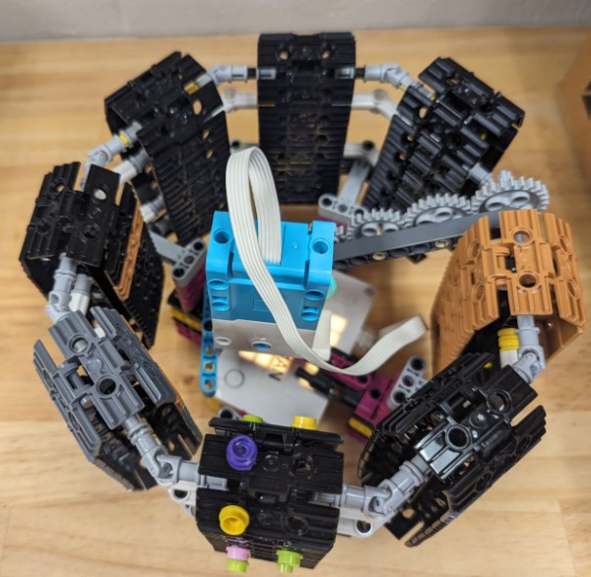
The Solution
Our solution is called the InfiniteClimb+. It consists of 6 to 8 vertical treadmills placed in a pentagonal formation, to allow infinite climbing surface and jumps in all different directions. All treadmills include holds on them. There are also safety features, including a safety stop when the user’s foot reaches the bottom of the treadmill, and a safety foam mat around the entire solution in case of fall. The treadmills also tilt at different angles to make the climb easier or harder. Speed can also be adjusted using a kiosk on the side of the treadmills. We have two versions of InfiniteClimb+, which are standard and luxury.

Slide 14
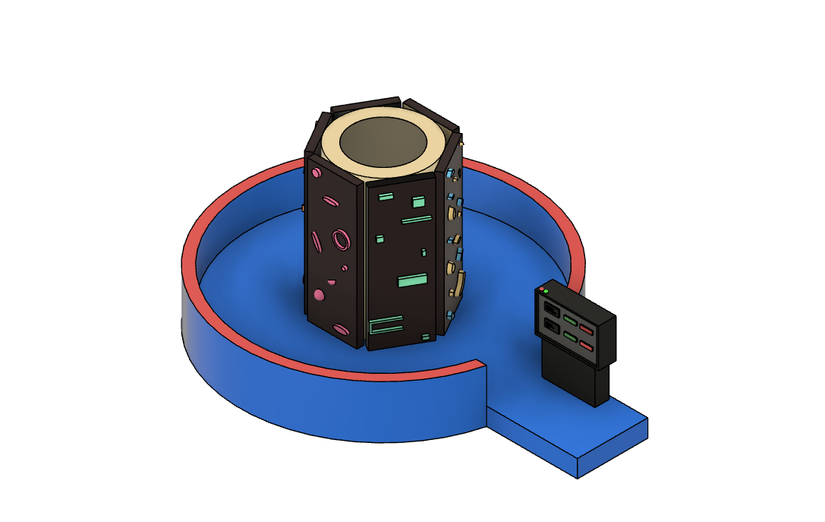
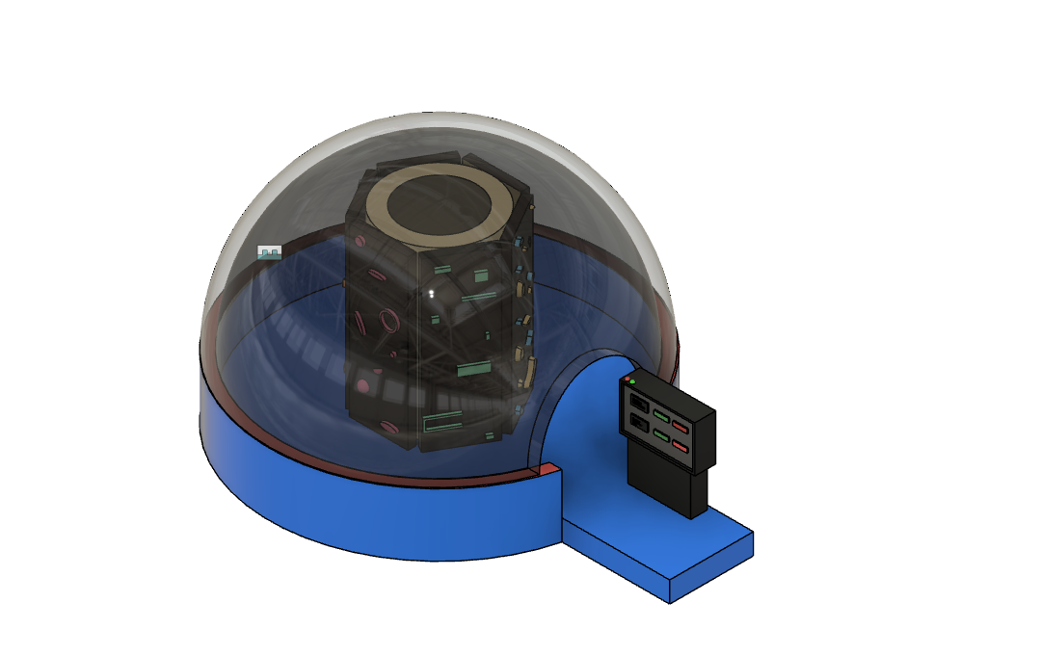
Luxury Version
Standard Solution
This version is for climbers who look for a longer climbing immersive experience. This option also includes the following:
vibrating holds so that the vision impaired or blind could follow a path,
holds that are illuminated,
speakers for music, and
screens to simulate a personalized climbing environment (e.g., mountains).
Tilts for more of a challenge for advanced climbers or easy climb for beginners
This version is for climbers who don’t need such an immersive experience while climbing because they are either beginners, looking for a light and brief workout.

Slide 15
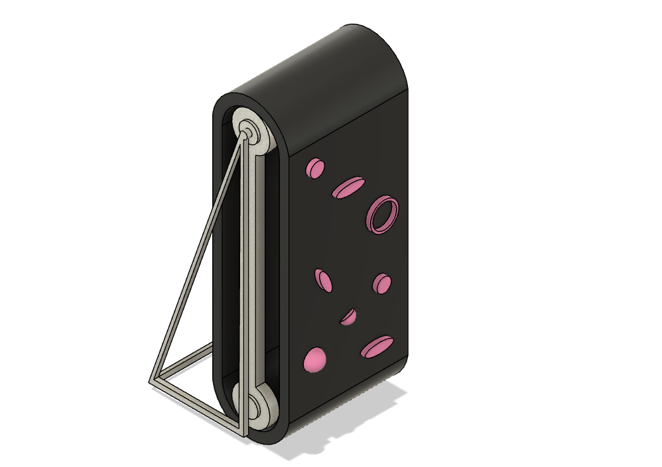
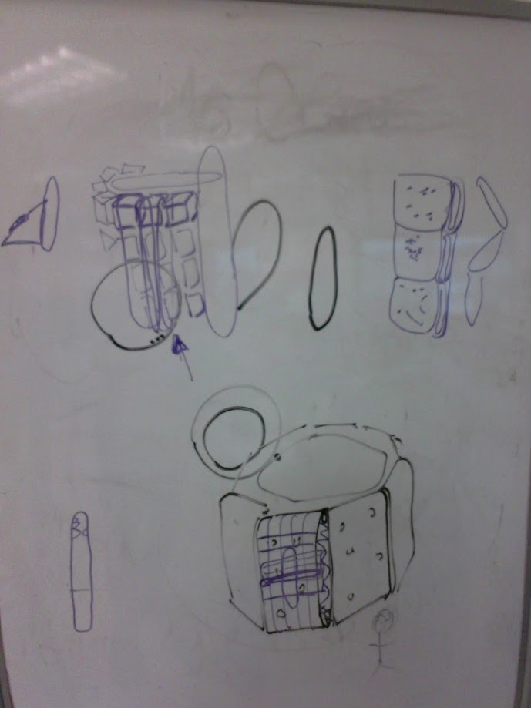
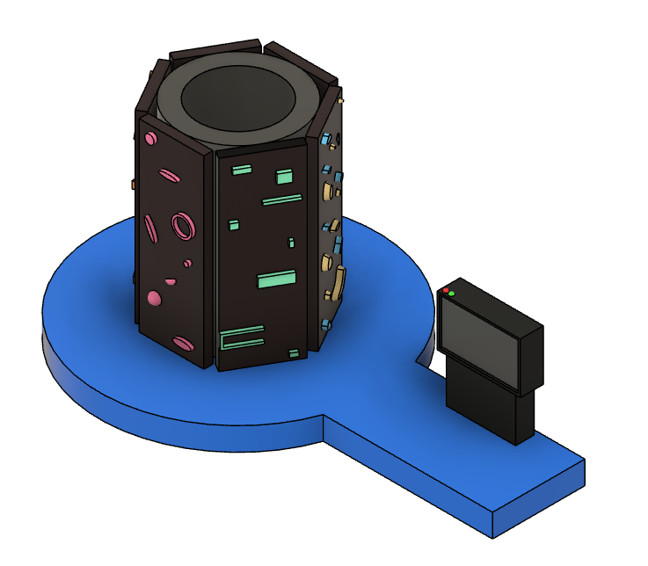
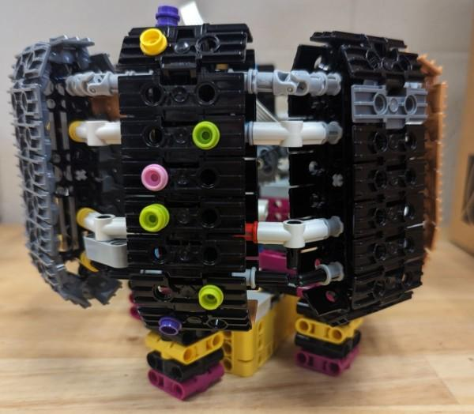
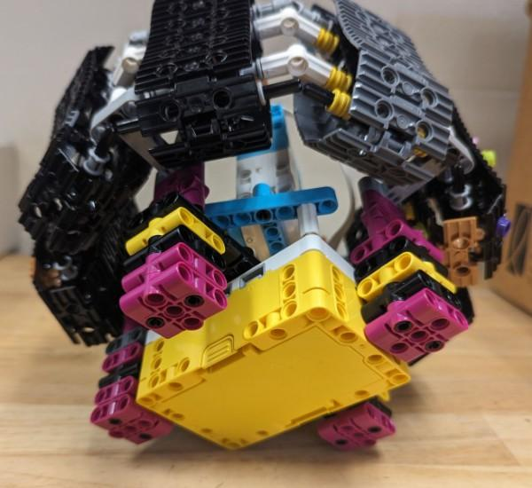
Innovation Model Iteration
Mar 12: had the idea of making a solution with only one rock climbing treadmill (model made on Autodesk Fusion 360)
Mar 15: had an idea of stacking multiple treadmills together (later realized it would be too high up and dangerous)
Mar 15: changed idea to make a solution with 6 treadmills that were put in a pentagonal formation for more climbing area and jumps with two way directions
Mar 10: voted 6 out of 6 for rock climbing out of the other and problems and brainstormed ideas for how our solution could potentially be different and better than other solutions
Mar 24: finished a new Autodesk Fusion 360 model with mats and a screen to control features, such as speed and two way treadmill
Apr 5: used feedback from Adam Catalano from the edge at a March 25th meeting to finally finish a new Autodesk Fusion Model; an immersive luxury version with a screened dome; and normal version with side foam for extra protection
Apr 5: also finished our lego model of InfiniteClimb+ using a hub

Slide 16
Major Iteration:
Now: We have 6-8 normal vertical treadmills, because with help from Adam Catalano two way treadmills aren’t necessary. Climbers don’t climb sideways as much, and vertical treadmills themselves already allow infinite climbing area. Also, added immersive experiences.
Where We Started: We Used InfiniteClimb+ using 6-8 two-way treadmills, so climbers can climb in two directions and sideways with more freedom in climbing area

Slide 17
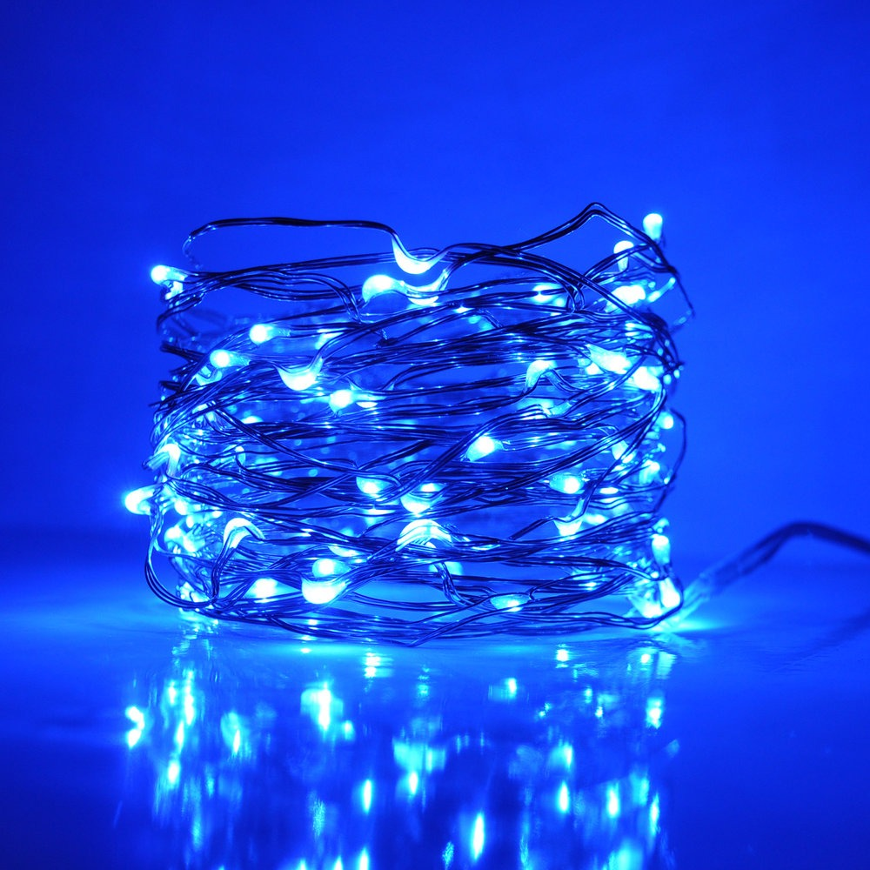
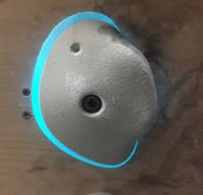
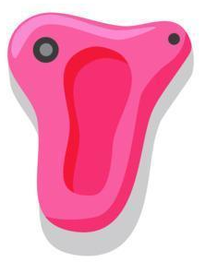
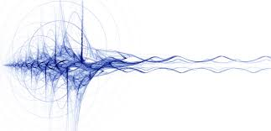
Our Features On Special Holds
These holds are for beginners, who need a guided path without an instructor screaming at them to take a certain path, or blind or deaf climbers. The feel and hearing of vibrations connected through a motor on the holds, can help lead blind climbers to know which hold to reach for. Deaf people can see which holds to climb on through led lights that would light up a path to take. We noticed this was a problem when we visited the Edge. The adults would scream at us to climb and reach for certain holds.

Slide 18
Cost & Profits
Standard Version:
Full cost = $11,470
Full cost with profit = $13,764
Profit = $2,294
_____________________
Luxury Version:
Full cost = $15,970
Full cost with profit = $19,164
Profit = $3,194
_____________________
General Profit = 16.67%

Slide 19
Materials part of our solution
Standard version:
One side treadmills (6)
Holds (300)
LCD Display (6)
Kiosk (1)
Mat (1)
Foam (8)
Stop sensors (6)
Supports (6)
Luxury version:
Has all, but also includes Immersive features
Projecting dome (1)
Speakers (6)
Light-up holds (300)
Vibrations

Slide 20
Resources Used
Autodesk Fusion 360 (fusion model)
monday.com (progress tracker)
Legos and Hubs For our Lego Model

Slide 21

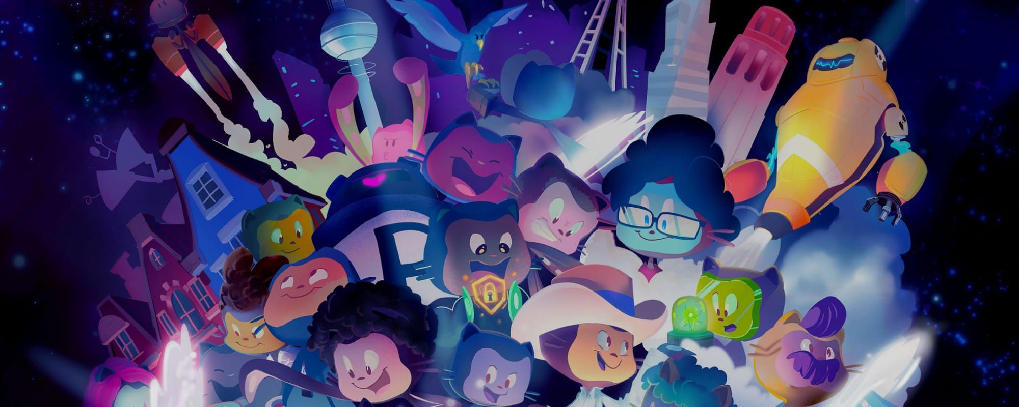

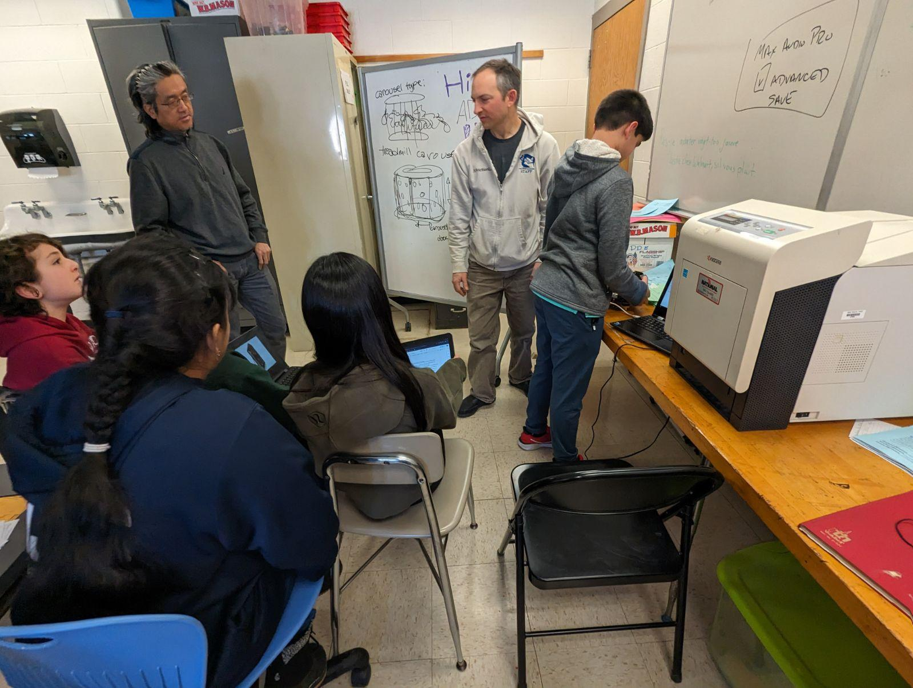


Experts + Outreach
We talked to Adam Catalano from The Edge, an indoor rock climbing gym/area in Halfmoon. He came to one of our meeting to give us feedback on the Infinite Climb. One piece of advice he gave was to reduce the height: we originally had it had 10 feet, but he said to reduce it to about 8 feet, because you would be climbing a treadmill and not really going anywhere.
Outreach:
Bookmarks - Distributed to Shen Middle School Libraries, Albany Library, and FLL Club members
Open Source License on GitHub
Team Website - Brochures & Bookmarks
11.11.23 - Albany Library Washington Branch
(Science Time With Mr. Bill Mielke)
Shen Robot Rumble & Second Shen Robot Rumble
FRC Tournament At MVP Arena
1.26.24 Shen First Explore Festival
4.19.24 Shen Science Health & Discovery Night
Prishita: Field hockey - team not communicating, training, and field conditions
Sasha: Generally, finding time for hobbies.
Jacob: Parents believe too much time doing just one activity
Eli: Not enough time. Not always having the materials to work with. The process is time consuming. The resin mixing takes lots of time to mix. The mechanics are time consuming. Have to watch the laser for many hours. Researching the equipment to use is time consuming.
Audrey: need to learn how to cook/bake better; lots of waste when cooking/baking doesn’t go well; don’t get good feedback to get better.
Yuhan: painting - supplies are expensive. Watercolor takes longer to dry. You can’t cover up with water color but you can with acrylics.
Rishabh: hard to learn to draw online, training needed to be better at soccer, training is expensive

